Slide 1
KI.NRW - AI4EU joint Playground

Slide 2
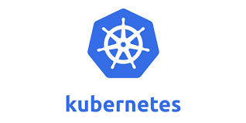
Playground Context
Separate Systems
AI4EU Experiments
Playground
Execution
Onboarding
Collaboration
Federation
Deployment
Streaming Orchestrator
Pipeline Composition
Catalog

Slide 3
Playground Concept
Integrated with SSO
Automatic Deployment
No CLI access needed
Not for confidential data or models
Periodic deallocation of resources (pipelines, docker images, etc.)

Slide 4
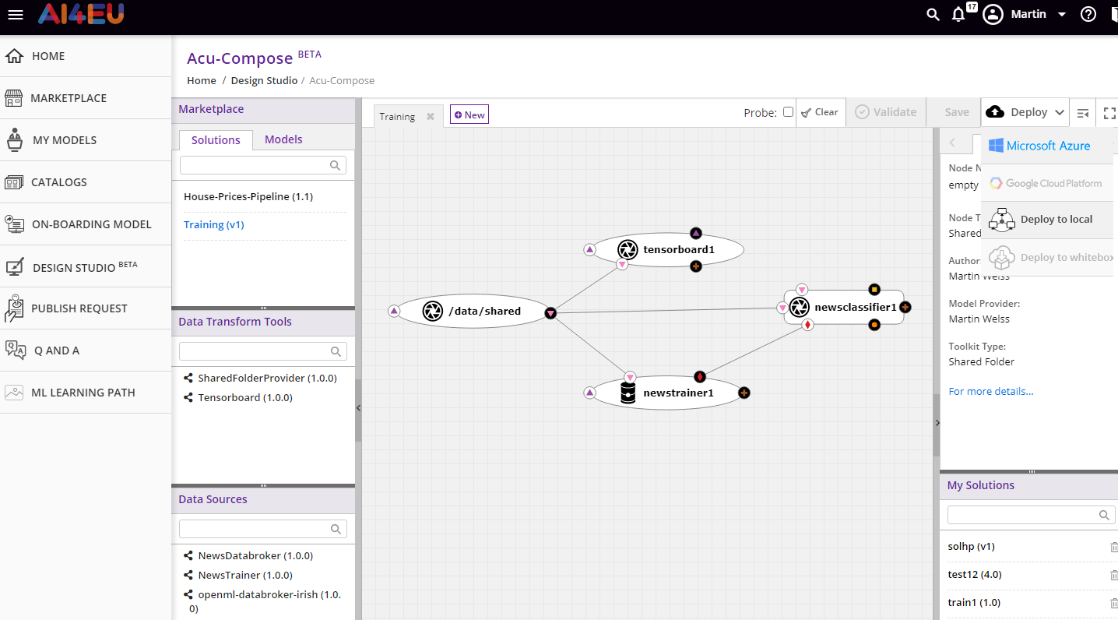
Deploy to Playground
Deploy to Playground
Playground
Integrated with SSO

Slide 5
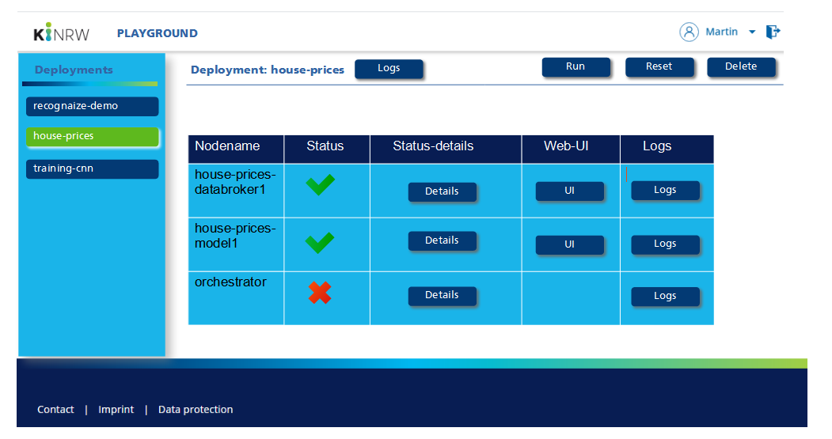
Playground Overview

Slide 6
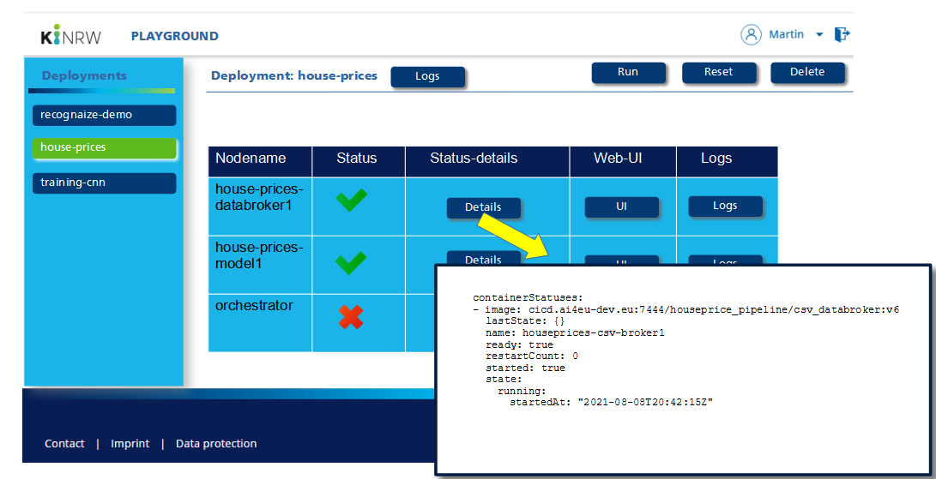
Node Status Details

Slide 7
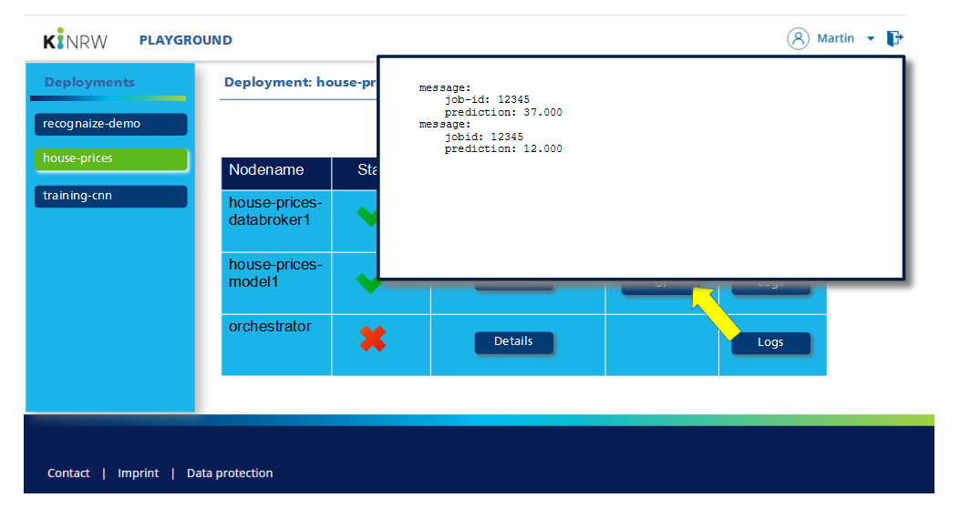
Node Logs

Slide 8
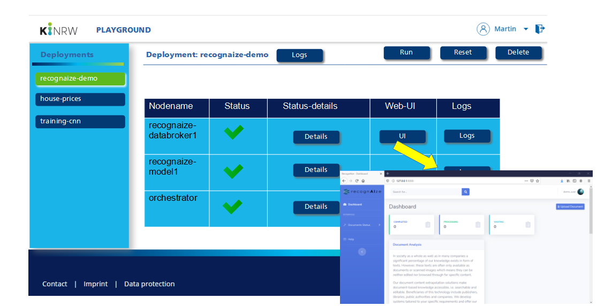
Node Web-UI

Slide 9
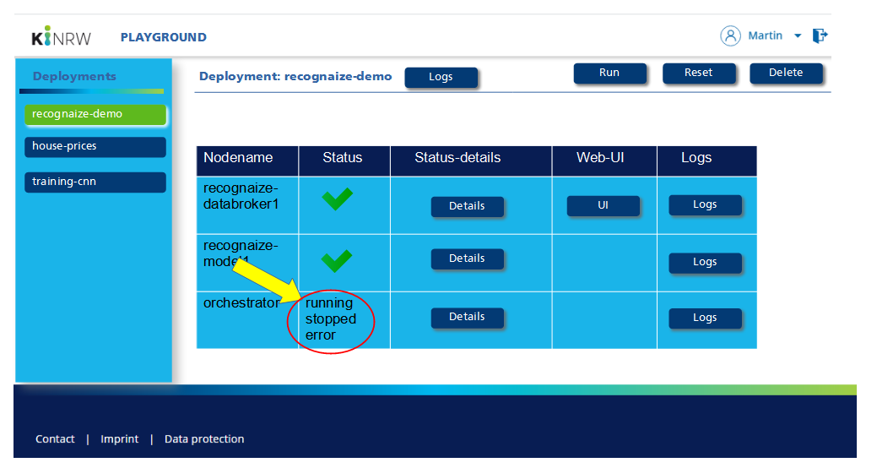
Orchestrator Status

Slide 10
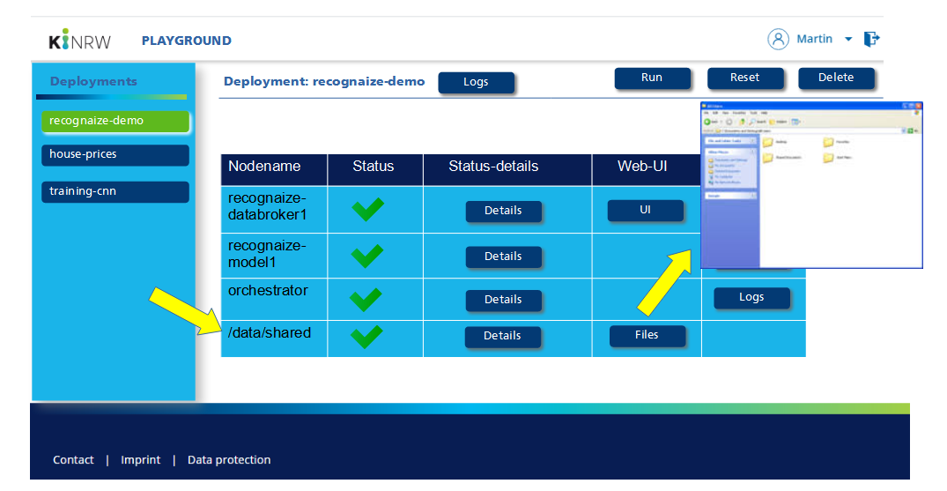
Shared Folder

