Slide 1
ROS Interface for gRPC model servers
Ragesh Ramachandran (Fraunhofer IPA)
Ansgar Radermacher (CEA)

Slide 2
Suggestions from Martin Weiß
Add view of three roles involved in the scenario:
The model provider: what tools does he has to use and what must be included into the docker container? (or are there several?)
The user of a ROS integration pipeline: what are the typical nodes of such a pipeline? (How would a pipeline in the design studio look like?)
The deployment user: any specialities for deployment?

Slide 3
AI4EU Platform goals
Deployment of models
The model is deployed directly on the robot, respectively its controller unit.
The model is deployed centrally on-site.
The model is deployed in a cloud environment

Slide 4
Motivation
ROS currently does not have a standard infrastructure for using ML models
Every iteration on model required rebuilding the complete workspace
gRPC model server will remove the ROS dependency on ML libraries
Leveraging the combined capabilities of ROS and AI4EU platform
darknet_ros/ETHZurich
Notes:
Robotic application developers have started using ML models in ROS packages heavily.

Slide 5
Goals
Develop a standard framework in robotics for using ML models with ROS
Develop an interface from ROS to gRPC model servers from AcumosAI

Slide 6
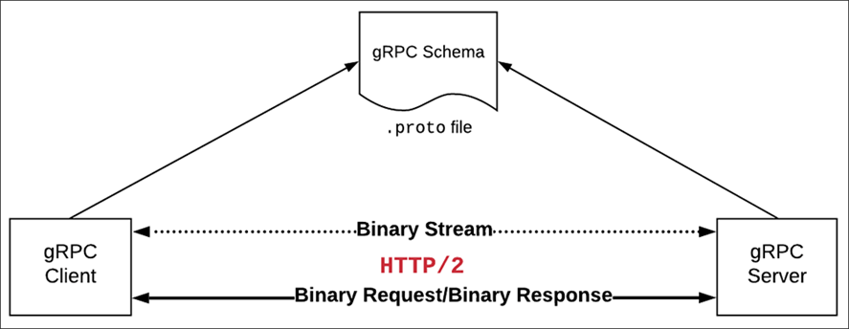
ROS pkg generator
Impact on Model provider
Our solution begins from the gRPC schema provided by the model provider.
No additional resources requirement from model provider
Zero impact on the model provider
gRPC-ROS client

Slide 7
Integration of package generator to AI4EU pipeline

Slide 8
How the interface works
About the generator
Input: a precompiled descriptor set file (useful? proto file, automate descriptor set creation via protoc)
Outputs (see next slide) 1. A corresponding ROS2 message package including build files 2. A ROS2 gateway in python that forwards data in both directions
Implementation choice
written in Java/xtend (https://www.eclipse.org/xtend/) Text templates facilitate text creation

Slide 9
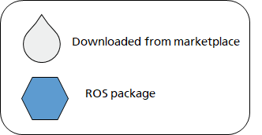
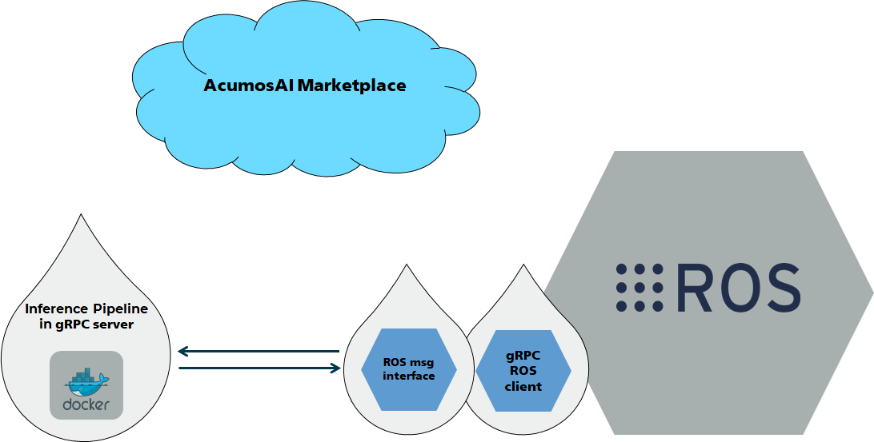
The deployment end user

Slide 10
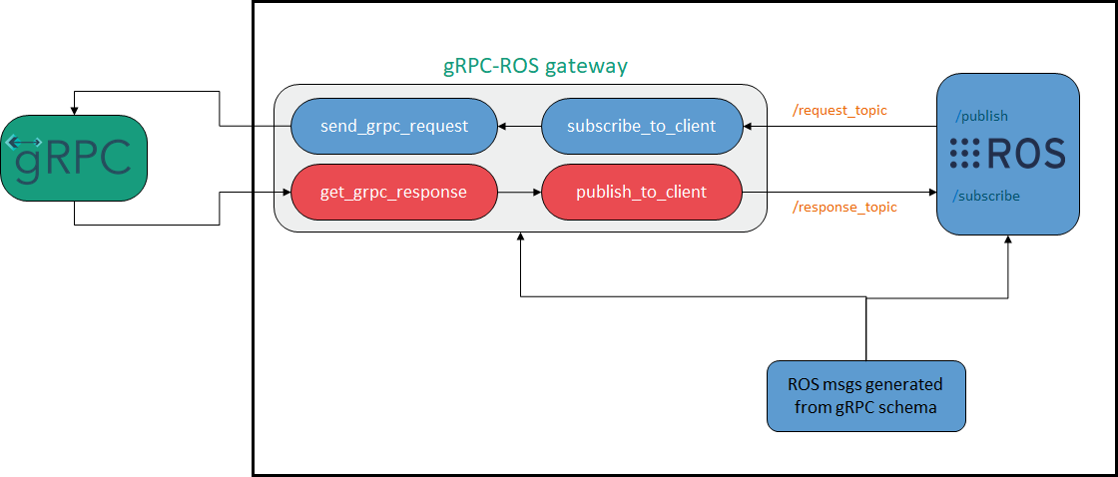
How the interface works
ROS workspace

Slide 11
Future works
Package the generator to a gRPC service
Integrate into AcumosAI pipeline
Support multiple RPC services per proto file
Extend support to auto generation of ROS1 (required?) and ROS2 C++ gateway
Priorities?

Slide 12
Open issues
How to package as a web-service?
Integration into chain
Input/output: file names, references (in a cloud storage) or data with file contents
Would a C++ client be useful?

Slide 13
Thank you
Feedback?

