Slide 1
AI4EU Experiments
New Feature: Streaming / Event-based Communication
Peter Schüller, TU Wien

Slide 2
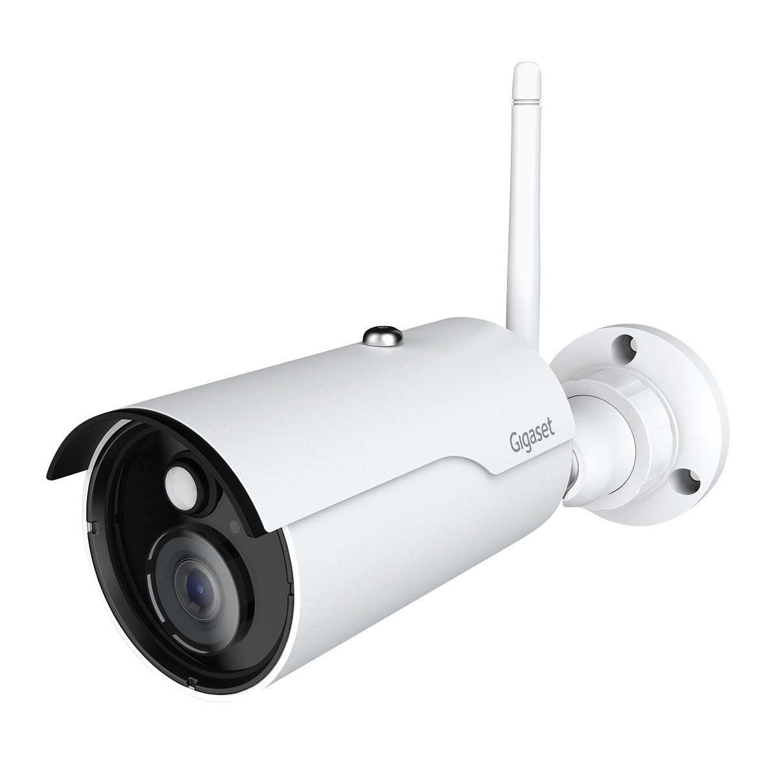
What can we do with streaming?
Event-based communication in general
Camera streams out images, other components process them
User Interface streams out user events and streams in results for displaying them
Events can be streamed out using multiple RPCs, each with a different message type
Results can be streamed in using multiple RPCs, each with a different message type
Each stream can process messages with a different message frequency
Control loops are possible
Similar to User Interface: simulator → sensor → controller → actuator
Components use other components as Subcomponents
Stream out requests & stream in results
Integration of ROS components: stream out = publish, stream in = subscribe

Slide 3
Component A can send events to component B
Event
(e.g., Image)
Component A
stream
output
stream input
Component B
output
A has interface “rpc call(Empty) returning (stream Event);”
E.g., A is a databroker and Event is a dataset to process
E.g., A is a GUI and Event is the data submitted in a form
B is the start of a processing pipeline/application

Slide 4
Component A can use component B as “submodule” (1)
Component A
(“caller”)
stream
output
Request
input (any type)
Component B
(“submodule”)
stream
input
Response
output (any type)
B has “rpc call(Request) returning (Response);” (stream for input or output is possible)
A has “rpc performRequest(Empty) returning (stream Request);”
A has “rpc processResult(stream Response) returning (Empty);”

Slide 5
Typical “Reasoner” Interactions are possible
E.g., interacting with a SAT Solver
Stream in “add clause/nogood” until the instance is fully constructed
Stream in “find next solution” ➔ stream out solution or UNSAT
Possibly stream in additional clauses to constrain the instance more
Caller
stream
output
Commands/Queries
Input
(stream)
SAT Solver
stream
input
output (stream)
Solutions/UNSAT/Cores

Slide 6
Example with Source Code: Streaming Sudoku
GUI
has interface https://github.com/peschue/ai4eu-sudoku/blob/streaming/gui/sudoku-gui.proto
streams out events in one RPC: https://github.com/peschue/ai4eu-sudoku/blob/streaming/gui/server.py#L44
streams in results in another RPC: https://github.com/peschue/ai4eu-sudoku/blob/streaming/gui/server.py#L63
internally has a gRPC server and a REST server and a jQuery-based web interface
Evaluator https://github.com/peschue/ai4eu-sudoku/blob/streaming/evaluator/sudoku-design-evaluator.proto
Calls ASP solver as a subcomponent via 2 stream RPCs: https://github.com/peschue/ai4eu-sudoku/blob/streaming/evaluator/server.py#L93 https://github.com/peschue/ai4eu-sudoku/blob/streaming/evaluator/server.py#L177 https://github.com/peschue/ai4eu-sudoku/blob/streaming/evaluator/server.py#L197
ASP Solver (the generic component)
is still the same as in the non-stream version

Slide 7
Topologies can be cyclic
Example:
Simulator
rpc simulatorOutput(Empty) returning (stream SensorData); rpc simulatorInput(stream Actuations) returning (Empty);
Controller
One actuation signal for each sensor input: rpc singleShotController(SensorData) returning (Actuations);
Observing sensor inputs and sometimes providing actuation signals: rpc streamingController(stream SensorData) returning (stream Actuations)
Simulator
stream
output
SensorData
input
Controller
stream
input
Actuations
output

Slide 8
How to create cycles
Use Empty input to initiate a computation:
Component A: rpc function1a(Empty) returning (stream Output); Component A: rpc function1b(stream Input) returning (Empty);
Component B: rpc function2(stream Output) returning (stream Input);
Remarks:
function2 could be implemented using 2 RPCs (like in Component A).
function2 could be without stream keyword (like the SingleShotController).
Component A
function1b
function1a
Empty
Empty
Component B
function2

Slide 9
Multiple Cycles are possible
(with different frequencies)
Simulator
stream
input
stream
output
Controller
Actuations (controller frequency)
stream
input
stream
output
stream
input
stream
input
World State
(simulator
frequency)
Interpreted
World State (perception frequency)
Low-Level Control Goal Information (sometimes)
Perception
stream
output
stream
input
stream
output
GUI
stream
input
Planner
High-Level Goal Information (user-dependent)
stream
output
stream input

Slide 10
Thank you for your attention!
A detailed workshop on the topic will be organized

Slide 11
The wrong way to do cycles
Component A
function1
This will not work (there is no starting point for Orchestration)
Component A: rpc function1(Input) returning (Output); Component B: rpc function2(Output) returning (Input);
Neither will this (same reason)
Component A: rpc function1(stream Input) returning (stream Output); Component B: rpc function2(stream Output) returning (stream Input);
Component B
function2

Slide 12
Streaming as Publish/Subscribe and Flexibility
A port with Empty input and stream output can be seen as “publish”
rpc publish(Empty) returning (stream Message);
A port with stream input and Empty output can be seen as “subscribe”
rpc subscribe(stream Message) returning (Empty);
To call a submodule you need 2 RPCs in the caller:
Publish requests and subscribe to results
To create a controller you need 2 RPCS:
In the controller: subscribe to sensor data and publish actuations
In the world/simulator: publish world state updates and subscribe to actuations
Stream input/output provides more flexibility for connecting with other components!

